Slide 1

Intern Final Presentation
Date: August 8, 2018
Alexandra Lu
- Company Private -

Slide 2
Final Presentation
Agenda
Intern Bio
Summer Objectives
Projects
Observations/ Recommendations
Q&A
Notes:
I’m going over a little bit about myself, my goals and roles for this summer, the projects I worked on, some comments on my experience, and there will be time for questions at the end.

Slide 3


Alexandra Lu (Alex)
Bio
Hometown: Flushing, New York
School: Stony Brook University
Major: Mechanical Engineering
Year: Class of 2020, Junior
Supervisor: Rob Spearing
Notes:
I’m from Flushing, New York and I’m currently a junior at Stony Brook University studying mechanical engineering but this fall I’ll be studying abroad in South Korea. My advisor was Rob Spearing

Slide 4
Function
Summer objectives
Objective 1: Gain hands-on experience working in a laboratory setting designing, preparing and conducting tests
Objective 2: Record and interpret experiment results and write appropriate documentation
Objective 3: Applying newly acquired and past skills to problem solve
Notes:
My first personal objective for this summer was to learn how to design, prepare, and conduct tests by actually doing them in the lab in addition to observing someone else do it
My second objective was to follow up and interpret the results/data from tests and properly document these findings; which in this case was in the form of a test assignment
Finally, I wanted to apply skills I’d learn here at Carrier and skills from school in order to problem solve and think analytically

Slide 5
Function
Projects
N2 purge tests with various valve sizes
Regeneration trials to reclaim XtendFRESH scrubber beds used in the field for over 3 years
Zeolite research – plan for test for CO2 removal for comparison
CO2 end of line at factory test concept
MCI Star Cool membrane module investigation
Panel Glove Gasket testing and results
Compression set
Heat aging
Pressure decay
Notes:
This summer I primarily worked on XtendFRESH-related projects.
A couple of these I worked alongside engineers, so my involvement was kinda limited
A lot of them are still in progress but have notes on future steps

Slide 6
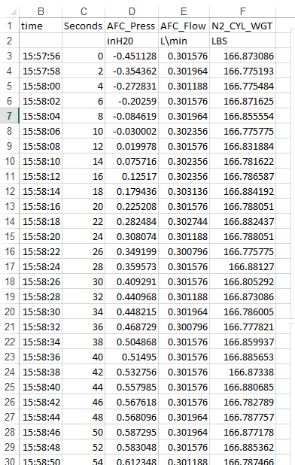
N2 Purge Port Sizing
Introduction to container tests
Examining if venting has an effect on O2 pulldown per pound of N2 due to pressure equalization
Graphed and analyzed pressure, N2, and O2 concentration measurements
Notes:
The first project I worked on was assisting Chip with the N2 purge port sizing tests
For this one, a nitrogen purge test was performed on 10 foot containers with various sized ports installed
The objective of this test was to figure out if type of venting, whether it be a valve, port, or vent, had an effect on the rate at which the nitrogen could bring down the oxygen level because the different sized port is a different means of pressure relief
Chip showed me how VISM worked, how to export the data, and guided me on how to analyze and graph the data from the tests and ensuring that all of the measurements taken matched in terms of time
Here in this picture is a screenshot of some of the data that was taken. We have time, pressure in inches of water, and N2 concentration

Slide 7
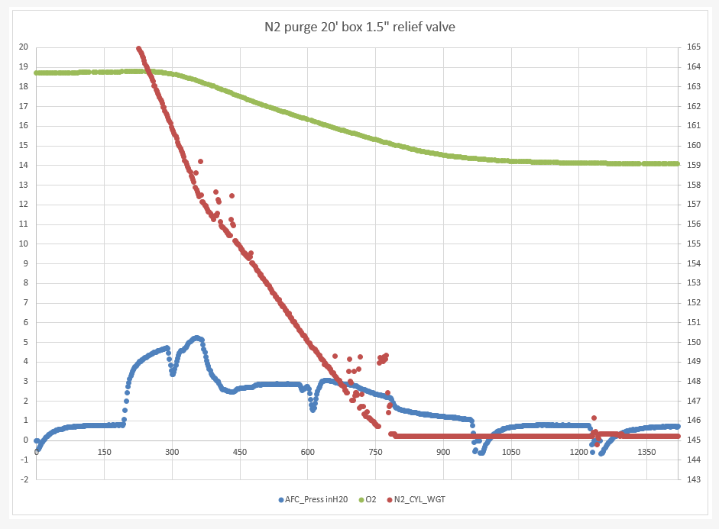
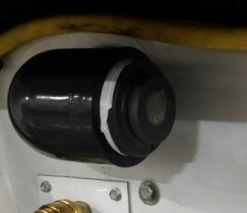
N2 Purge Port Sizing
1.5” relief valve (picture by Chip)
Determined that valve size had little effect
Notes:
This is one of the graphs I made, corresponding to the 1.5” relief valve
As you can see the red represents the N2 leaving the bottle and entering the container to cause that drop in O2, represented in green
It was determined that the valve size or type of vent had little effect on the O2 pulldown, each method showed similar % changes in O2 per pound of N2 (~0.53%)
However, further testing also showed that certain vents had an effect on the post-scrubbing O2 leak rate

Slide 8
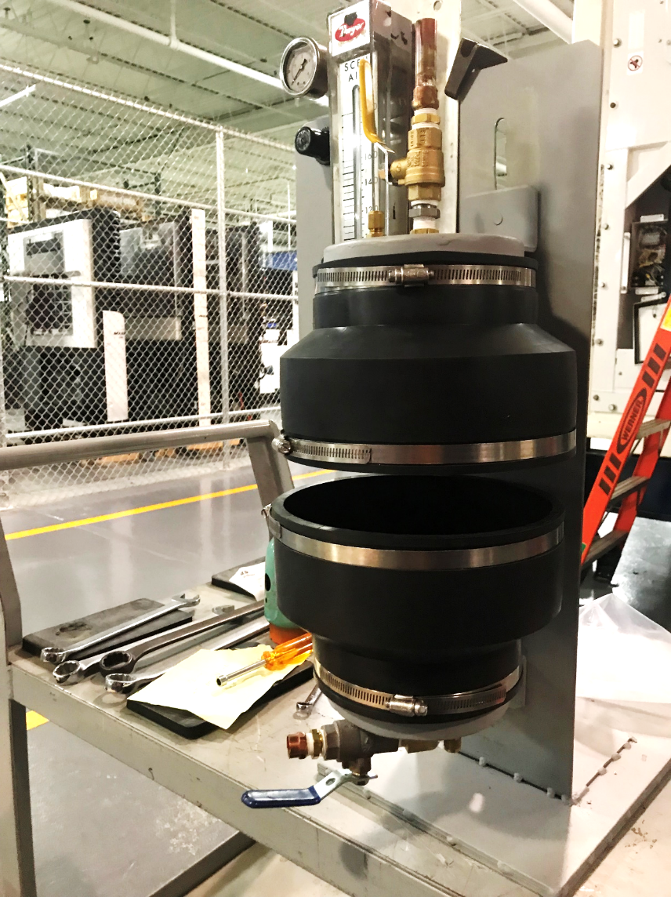
xtendFRESH Scrubber REgeneration
End of life scrubber beds return from field capacity reclaim
Test the feasibility of regenerating XtendFRESH scrubbers to original CO2 removal capacity
Tests performed
N2 flush
H2O flush test to remove CO2 particulate from bed
Notes:
The next project I worked on was assisting Farley in regenerating end of life XtendFRESH scrubber beds
The intention of this test was to see if it would be possible to return scrubbers back to their original scrubbing capacity using various methods
If it succeeded, it could be implemented in the factory as opposed to customers having to purchase entirely new beds
Using cartridges that were in the field for 3+ years, they were installed in units and the initial scrubbing capacity was calculated
Then we performed a N2 flush, using this apparatus, and a water flush test to see if it would remove CO2 particulate from the bed
The duration of each test varied. For the N2 flush it was 1 to 3 hours and for the water test it was 30 minutes to an hour
Afterwards, it would be installed back into the unit and the scrubbing rate post-regeneration would be calculated

Slide 9
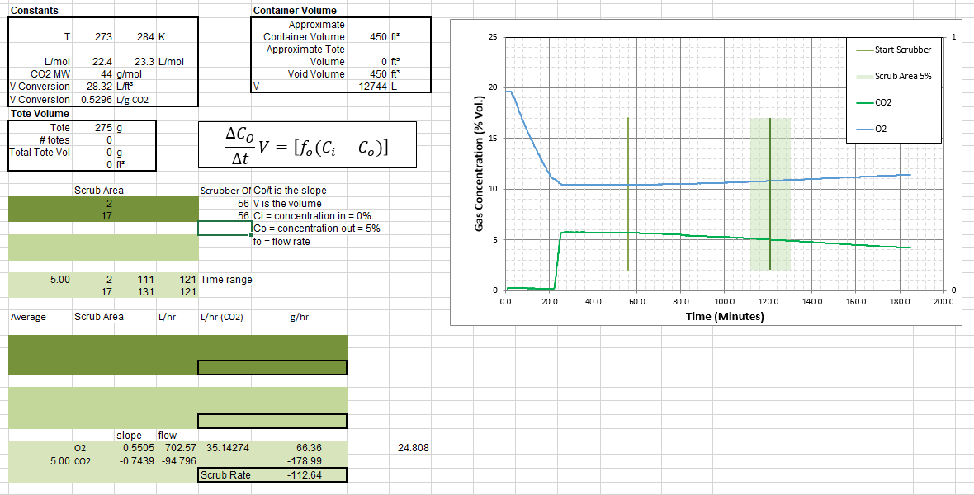
xtendFRESH Scrubber REgeneration
Calculated new scrubbing rate after regeneration
Notes:
For one of the tests, I calculated the new scrubbing rate after an N2 flush, which was found to be about 112 g/hr, up from 94 g/hr
Unfortunately, I couldn’t continue crunching numbers for this project because at this point I was dealing with IT issues and did not have email for a while
The scrubbing rate post-regeneration for both N2 and water flush did increase by 10-20%, but it wasn’t effective enough to justify further testing

Slide 10
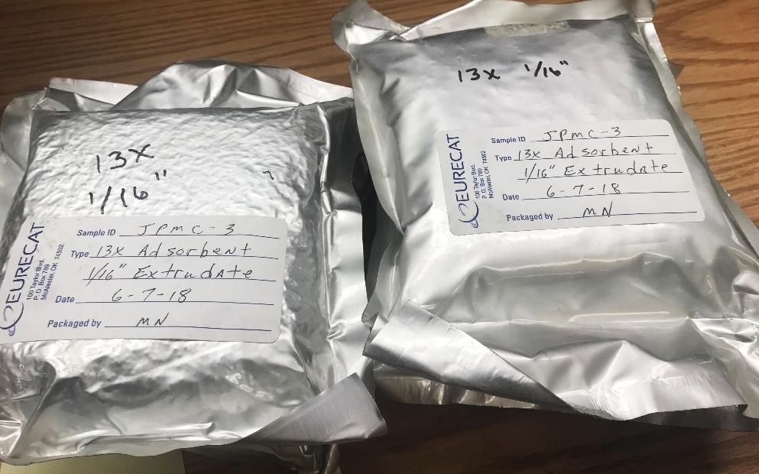
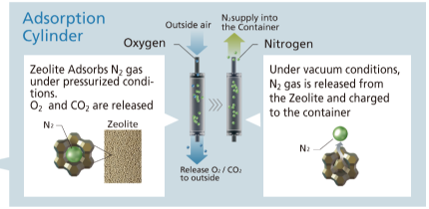
Zeolite Research
Exploring possibility of replacing activated carbon pellets in XtendFRESH scrubber
Researched properties of zeolite variants to find optimal type for CO2 removal
Contacted suppliers to order samples
Notes:
One of our competitors, Daikin, uses a type of mineral called zeolite, in their active CA filters
My next task was to do research on the properties of different zeolites and investigate the possibility of replacing the activated carbon in current XtendFRESH scrubbers with a type of zeolite.
There are over 40 types and my objective was to figure out which types could adsorb CO2 the best and to order a sample of it
There was a lot of material to sift through, as the use of zeolite has mostly been for alternative medicine and making laundry detergent. Most of it required reading through chemistry journals
Eventually I settled on Zeolite 13X, which was shown to adsorb both CO2 and O2
I requested quotes from several suppliers and eventually got an order

Slide 11
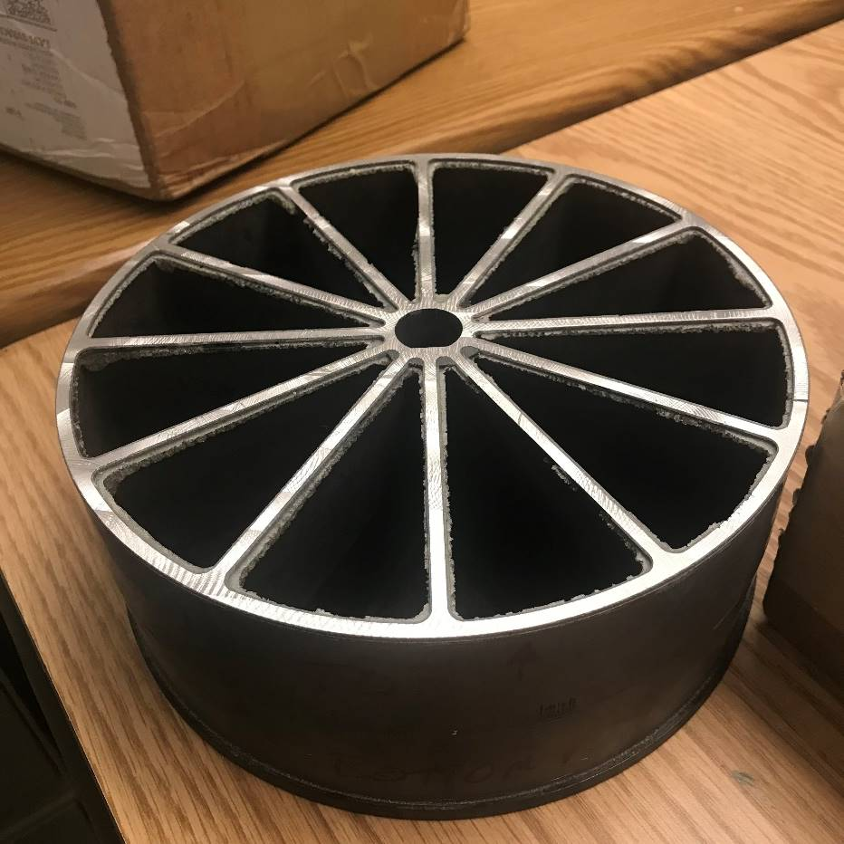
Zeolite Research
Removed seal from bed in order to replace activated carbon with zeolite
Next steps
Fill bed with zeolite pellets
Measure and calculate scrubbing capacity with bed installed in unit
Compare scrubbing rate
Notes:
The next step is to test the zeolite in XtendFRESH by replacing the activated carbon
I already had one seal machined off an old XtendFRESH scrubber, after that we would fill the bed with zeolite pellets and use epoxy to put a seal back on
Similar to the regeneration test, the following steps would be to install the bed into a unit and measure and calculate the scrubbing rate, compare it with the baseline of ~250 g/hr

Slide 12
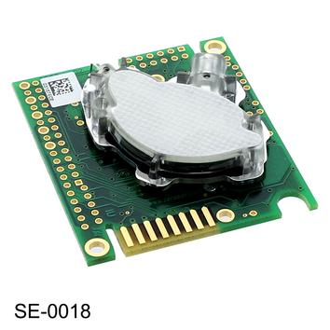
CTPL Scrubbing Capacity Test
Hapag-Lloyd visitation to factory requested means to confirm scrubbing capacity of assembly
Design a test to find the scrubbing capacity of an XtendFRESH scrubbing bed
Drafted a simple configuration of the setup
Identified CO2 sensor with appropriate sensitivity (~10,000 ppm) that could be utilized in test where CO2 content would typically be ~4000 ppm
K30 10,000ppm CO2 Sensor
Notes:
The CTPL scrubbing capacity project is based on one of our customers, Hapag-Lloyd, who visited the factory in Singapore and asked how we knew what the scrubbing rate of the assembly was
Unfortunately, there is no current test or apparatus specifically for that purpose, so the purpose of this project was to design a test to find the scrubbing capacity of an XtendFRESH bed
With the help of Chip and Rob we made a simple configuration of the setup for this test
And I identified a CO2 sensor with the appropriate sensitivity of 10,000 parts per million

Slide 13
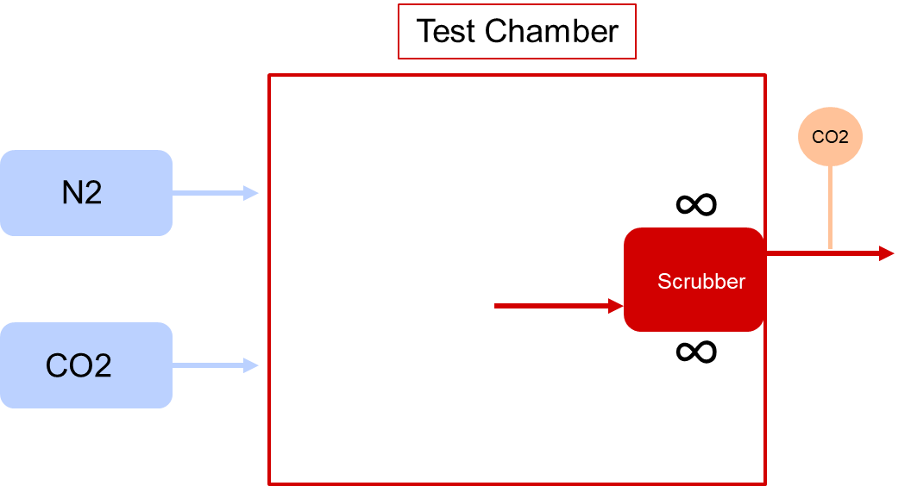
CTPL Scrubbing Capacity Test
Next steps
Find desired injection of N2, CO2
Acquire remaining materials (fans, scrubber, sensors)
Assemble and test
Notes:
Here’s a basic configuration of what we imagined the test setup to look like
We have a desired amount of N2 and CO2 entering a sealed chamber and fans that are running on either side of the scrubber to mimic air circulation in a container
There’s a CO2 sensor that measures how much is leaving the scrubber, and from there we can calculate the scrubbing capacity
The next steps would be to figure out exactly how much N2 and CO2 we want injected, acquire the remaining materials like the fans, a scrubber, and sensors for the inside of the chamber, then hopefully assemble it and start testing

Slide 14
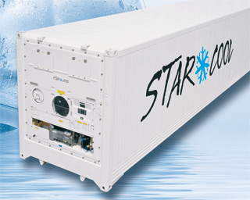
MCI Star Cool MEMBRANE Investigation
Examine the mechanics and performance of Maersk Container Industry (MCI) Star Cool filter membrane
Compare Star Cool and XtendFRESH scrubbing rate
Unassembled the membrane with help of lab technician
Researched cross flow filtration system
Notes:
The next project was to investigate the filter membrane for one of our competitors, MCI, which has a product called Star Cool that has the same purpose as XtendFRESH
The goal of this project was to compare the scrubbing rate of the Star Cool membrane with the XtendFRESH filter, but unfortunately I didn’t get around to doing that
Initially we thought an apparatus could be built to test the scrubbing capacity, similar to the one aforementioned, but the design of the filter makes it more complicated so it would probably be easier to use the unit that’s in the back of TR-19 and running that
However, there was some preliminary testing done (not by me) with Star Cool, so those numbers could be useful in future testing
With the help of a lab tech (and Enso) we unassembled the filter and I did some research on cross flow filtration, which is how the membrane gets rid of CO2

Slide 15
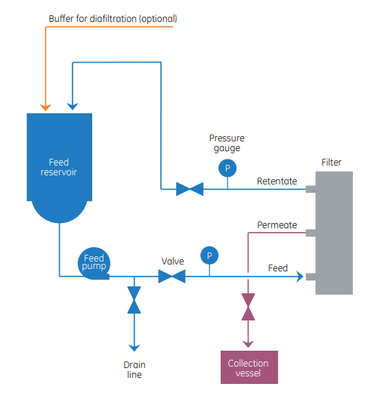
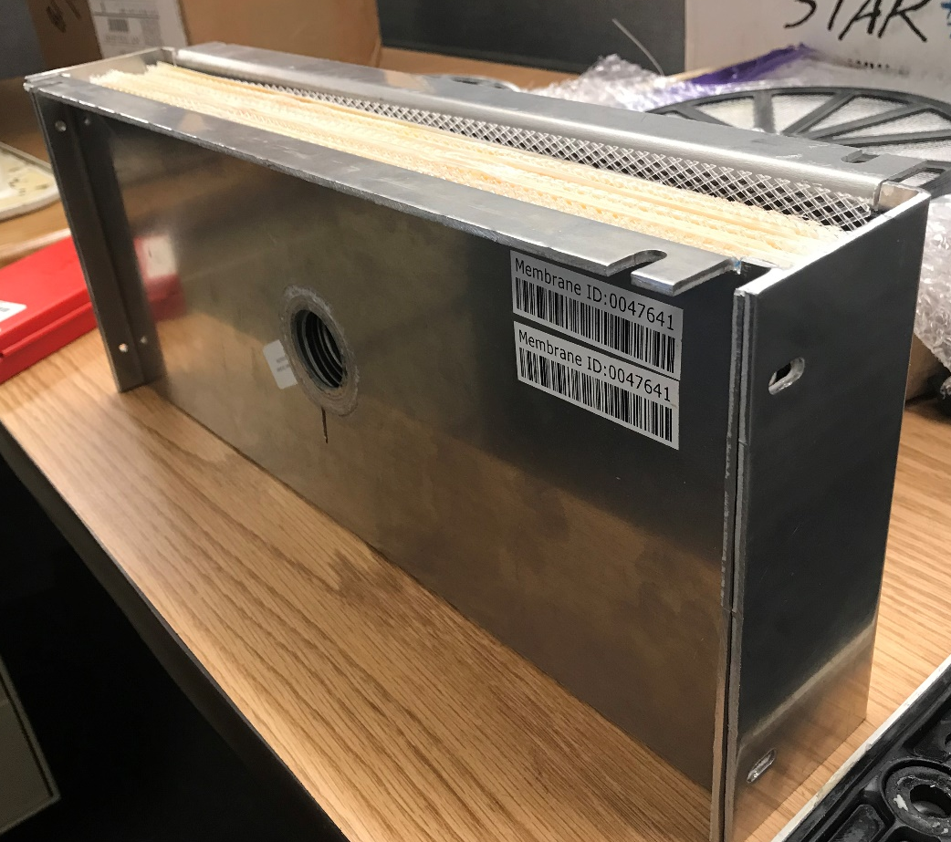
MCI Star Cool MEMBRANE Investigation
Retentate
Permeate
Feed
Left: Cross flow filtration diagram from GE Life Sciences Cross Flow Filtration Method Handbook
Notes:
This is how cross flow filtration works
Essentially, you have container air entering the filter, called the feed, and exiting through the top as retentate
However, there is a vacuum that pulls the permeate, or the CO2, out of the filter, perpendicularly from the direction of the feed

Slide 16
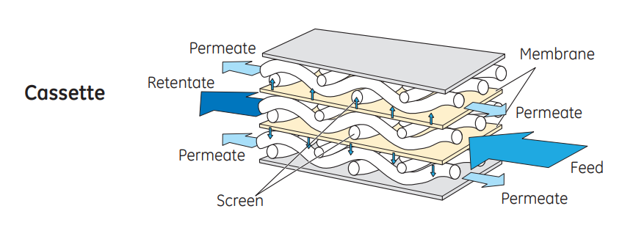
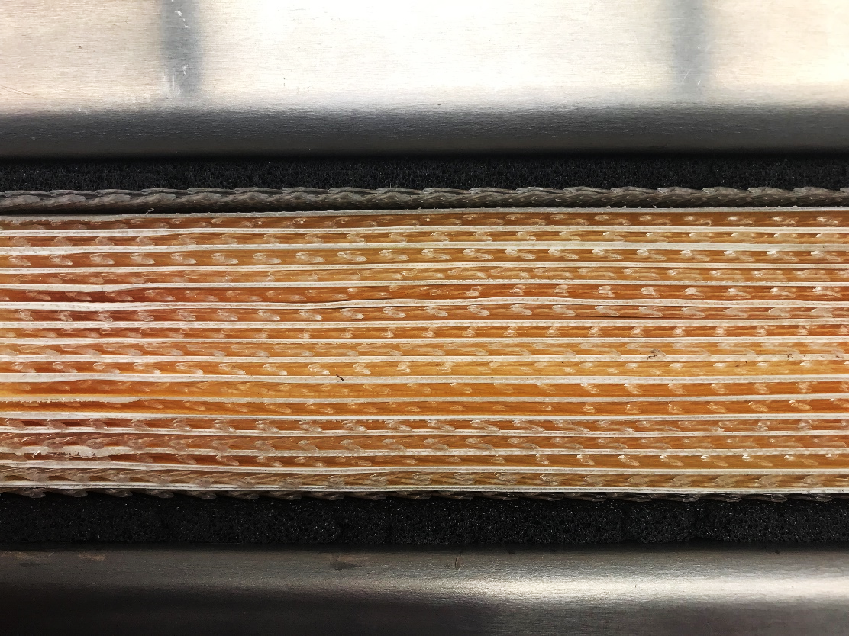
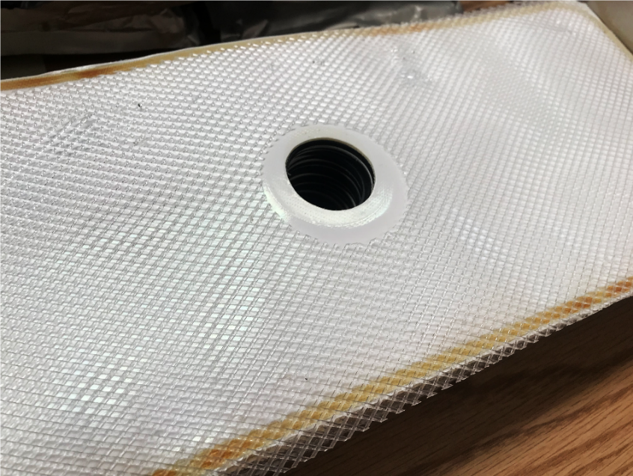
MCI Star Cool MEMBRANE Investigation
Left: Cassette diagram from GE Life Sciences Cross Flow Filtration Method Handbook
Notes:
The Star Cool membrane uses a type of cross flow filtration called a cassette, where the air flows through these sandwiched sheets pictured here
The texture of these sheets causes the unwanted material, or the permeate, to get stuck in these screens, which is then vacuumed out from this hole

Slide 17
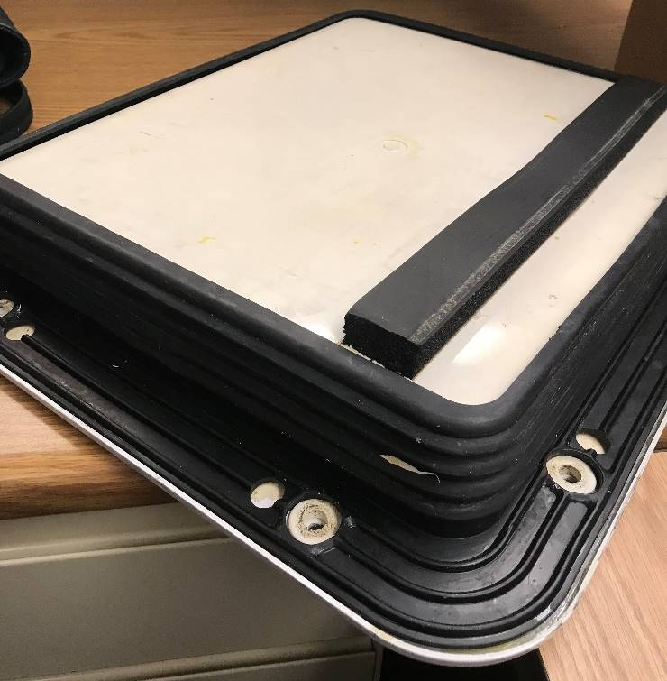
Panel Glove Gasket Testing
Worked alongside Cyril to conduct preliminary tests on a new gasket
Goals
Determine pressure decay results
Determine torque requirements
Evaluate compression set
Heat aging of gasket
Load over time
Notes:
The project that took the most amount of time was the panel glove gasket testing as shown here
I worked with Cyril to conduct some preliminary tests on a new gasket that would be installed with the XtendFRESH and fresh air panels to prevent air leakage
The goals of these tests were to determine pressure decay results, determine torque requirements, and evaluate compression set by doing a heat aging test and measuring the load over time

Slide 18
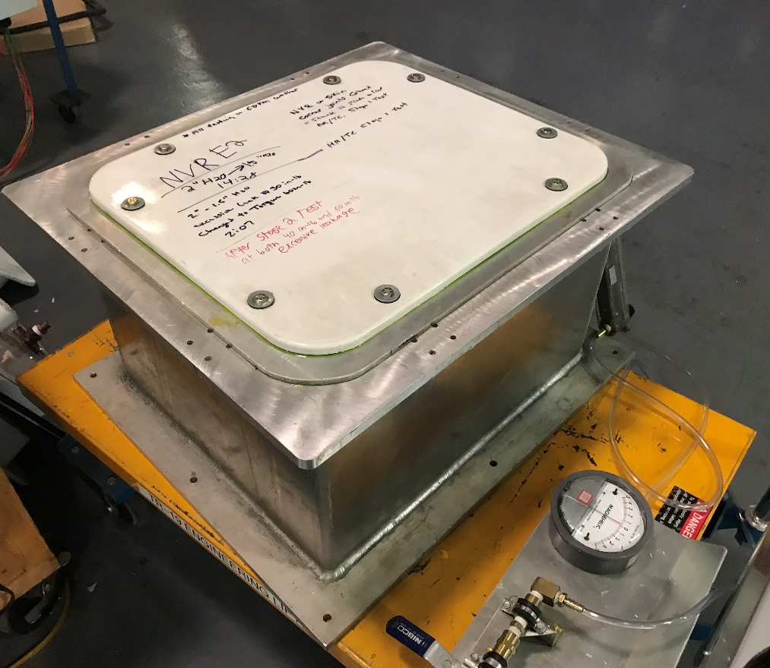
Panel Glove Gasket Testing
Pressure Decay Test
Performed pressure decay tests to evaluate gasket’s effectiveness in preventing air leakage on both panels
Timing how long it takes to go from 2-1” wg
Pass: >30 seconds
Notes:
First we performed pressure decay tests on both panels when it was installed onto this chamber
For those of you unfamiliar, this involved injecting the chamber with air and timing how long it would take for the air inside to “leak” out
We timed how long it would take for the pressure inside to go from 2 to 1 inches of water
The test would be considered a pass if it took longer than 30 seconds

Slide 19
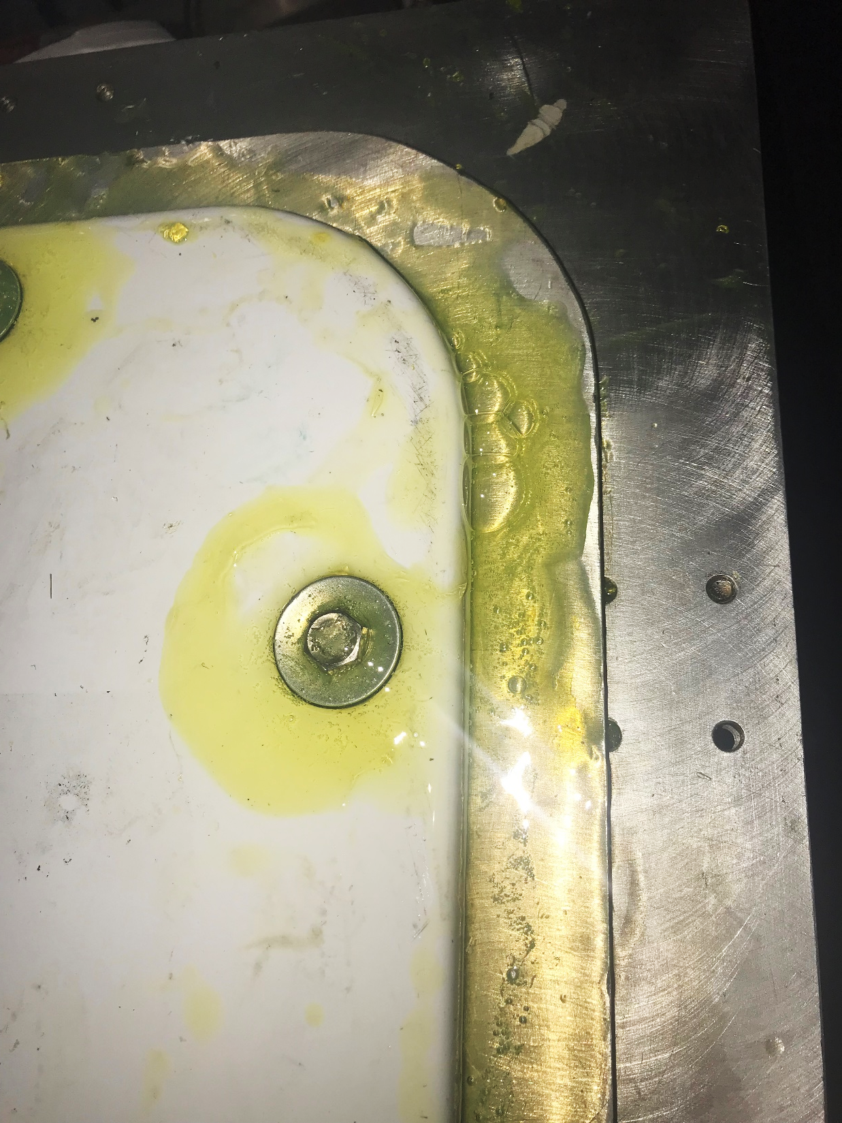
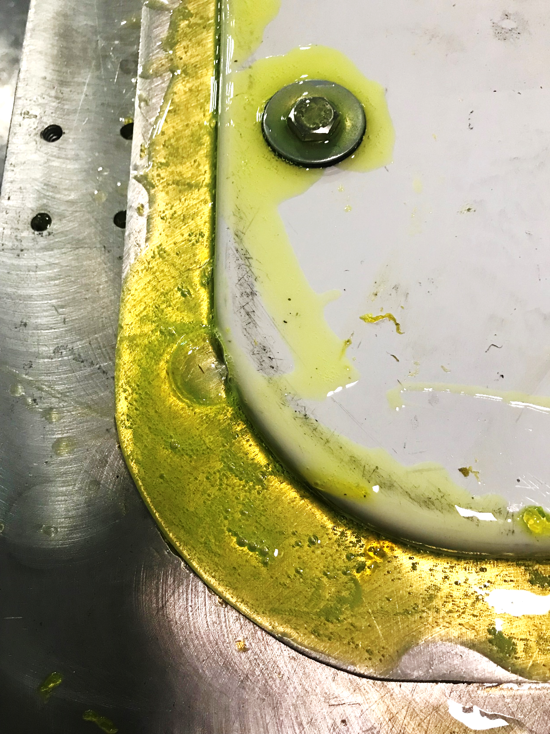
Panel Glove Gasket Testing
Pressure Decay Test
Inspecting panel for leaks using gas leak detector
Required troubleshooting
Tightening bolts
Using Teflon tape
Removing silicon
Switching out panel
Notes:
When timing did not pass, which happened on multiple occasions, it required us to do some troubleshooting to minimize the leakage
As you can see here, we have bubbles that indicate that air was leaking from some of these locations
So we tightened the bolts by increasing the torque to 140 in lb
Added Teflon tape to the bolts because we saw air bubbles
Removed silicon that was on the inside of the panel
And in one case, switched out the panel entirely
We also had to perform the testing in a different way (removing and reinstalling panel) to replicate installation variances, this meant more work and time but it’s truly necessary to obtain accurate results that would reflect those in the field
There was a lot of trial and error involved

Slide 20
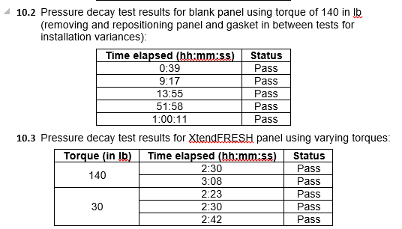
Panel Glove Gasket Testing
Pressure Decay Test
Documented and analyzed data to present to managers
Found that gasket majorly reduced leak rate for both panels
Future testing may be required for more consistent measurements on ABS panel
Notes:
After doing the troubleshooting, we compiled our results and showed it to Rob and James Nash
We found that the gasket reduced the amount of leakage for both panels A LOT, as you can see we have times of almost an hour for the ABS panel
However, future testing may be required for more consistent measurements on the ABS panel
Whereas the ABS panel failed multiple times until the torque reached 140 in lb, we found that the times for the XtendFRESH panel were pretty consistent regardless of the torque, and this is most likely due to the slightly different dimensions it has in comparison to the ABS panel

Slide 21
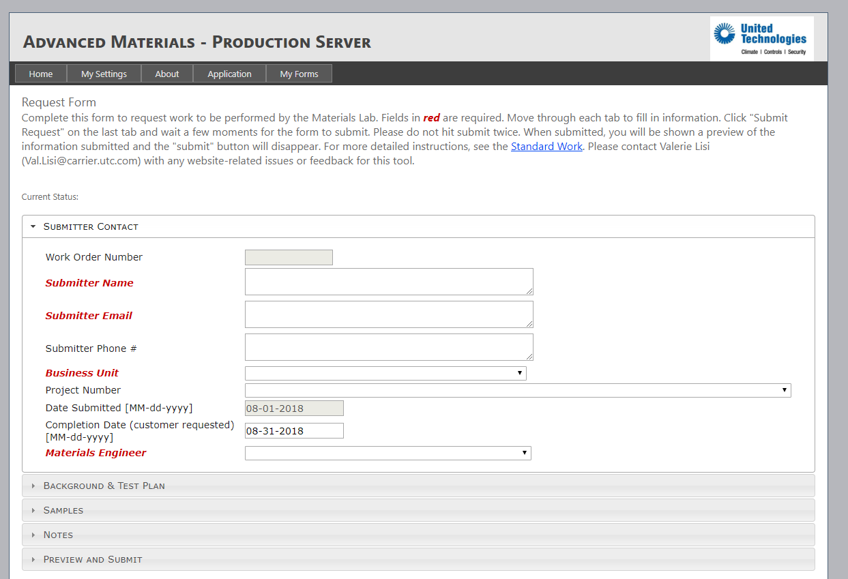
Panel Glove Gasket Testing
Heat Aging Test
Requested heat aging test from materials group
Placed gasket under 60C for 24 hours
Notes:
After that we requested a heat aging test from the materials group, where they placed the gasket under 60 degrees Celsius, which is about 140 degrees fahrenheit
The purpose of this test was to rapidly age the gasket under a high temperature for a long period of time, 24 hours, and see if it caused any deformations

Slide 22
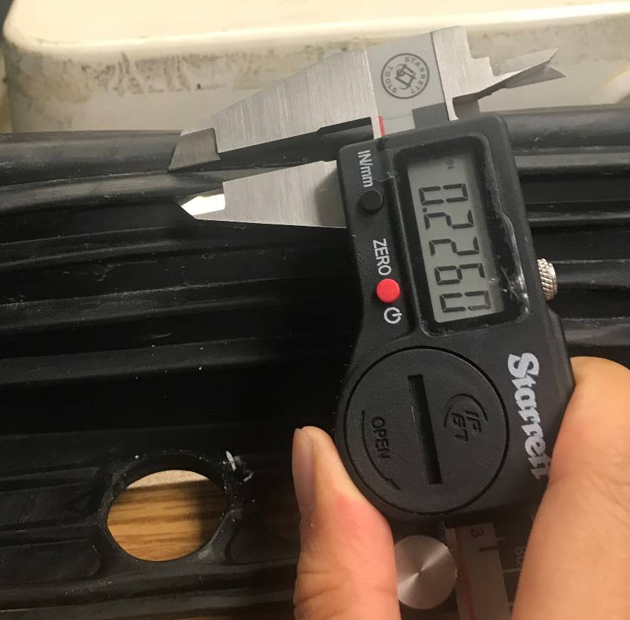
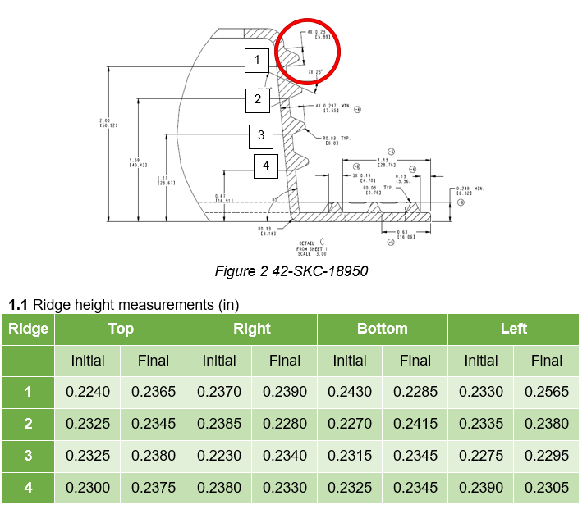
Panel Glove Gasket Testing
Heat Aging Test
Used calipers to measure ridges before and after heat aging
Gasket showed little signs of deformation
Average change in height +0.0032 in
Notes:
I used calipers to measure the height of these ridges before and after the heat aging
There was little signs of deformation, and the average change in height was plus 3 thousandths of an inch
One thing I will note is that it’s difficult to tell how accurate these measurements are because the material is elastic so it would move when I measured it, but regardless of whatever change in measurement there was, the average change is so miniscule that the error would be irrelevant

Slide 23
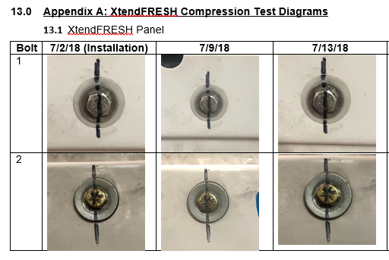
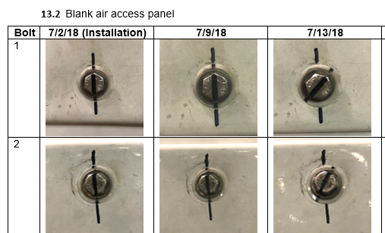
Panel Glove Gasket Testing
Compression Set Test
Installed XtendFRESH and fresh air panels onto old unit
Checked bolts on a weekly basis to inspect change in torque
After 3 weeks:
Fresh air panel – 125-130 in lb
XtendFRESH panel – 135-140 in lb
Notes:
Finally, the last part of the gasket testing was doing a compression set test with a load over a long period of time
We installed XtendFRESH and fresh air panels with the gasket onto an old unit, initially torqued at 140 in lb
After 3 weeks we found that the bolts on the fresh air panel were at 125-230 in lb and for the XtendFRESH panel they ranged from 135 to 140 in lb
Difference in change could be due to height embossment differences between the 2 panels
Torque relaxation is a lot less than the previous gasket that was being used

Slide 24
CCS at a Glance
Observations/Recommendations
Observations
Learned a lot beyond engineering
Work environment was pleasant
Constant communication is imperative
Recommendations
More consistent workload
Collaborate with other interns
IT issues

Slide 25

Thank You
Questions & Answers

